Slide 1
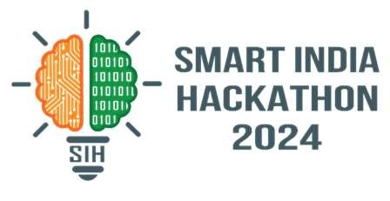

SMART INDIA HACKATHON 2024
MUSEUM TICKETING CHATBOT
Problem Statement ID – SIH1648
Problem Statement Title- Online Chatbot Based Ticketing System
Theme- Travel & Tourism
PS Category- Software
Team ID- GUSIH205
Team Name (Coding Crew)

Slide 2

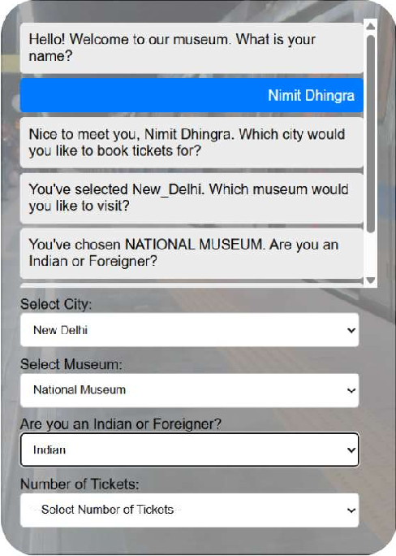
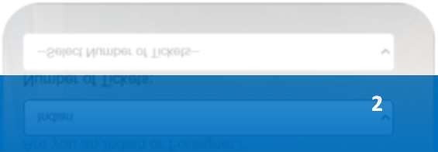
Museum Ticketing Chatbot
Coding Crew
Proposed Solution: A Seamless Ticketing Experience
AI-Powered Chatbot
Our chatbot uses natural language processing (NLP) to understand visitor inquiries and provide relevant information. It can handle basic inquiries, ticket purchases, and provide tailored recommendations.
Integrated Ticketing System
The chatbot seamlessly integrates with the museum's existing ticketing system, allowing visitors to purchase tickets directly through the chatbot.
Personalized Recommendations
The chatbot can recom m end
exhibits based on visitor preferences, providing a customized experience.
Multi-Channel Availability
The chatbot will be accessible through through various channels, including the including the museum's website, mobile mobile app..
@SIH Idea submission- Template
2

Slide 3
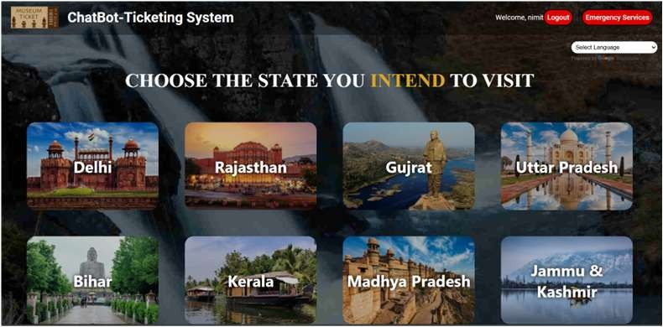
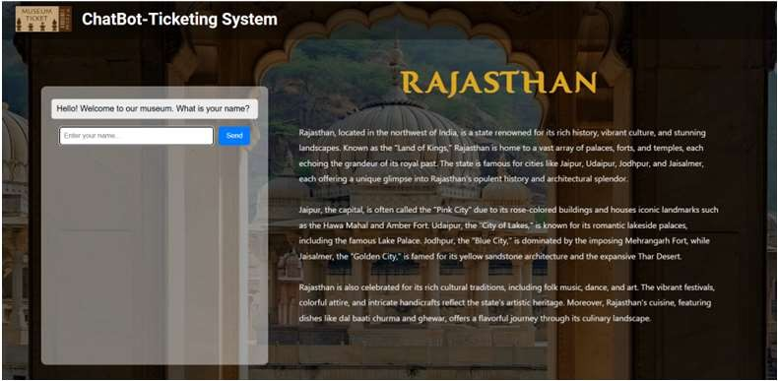
TECHNICAL APPROACH
Coding Crew
Building a Robust Chatbot
Natural Language Processing (NLP)
We will utilize advanced NLP techniques to enable the chatbot to understand user intent and respond accurately.
Machine Learning (ML)
ML algorithms will be implemented to continuously learn from user interactions, improving the chatbot's performance over time.
Database Integration
The ChatBot- Ticketing System also includes a login page which also stores the user’s login info for authentication
User Interface Design
The chatbot will have a user-friendly interface designed for seamless interaction across multiple platforms.

Slide 4

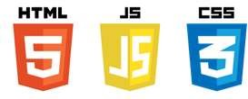

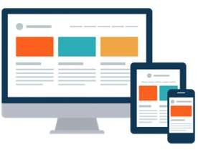
FEASIBILITY AND VIABILITY
Addressing Challenges and Risks
Coding Crew
1
Data Security
2
Technical Integration
Secure data storage and transmission will be prioritized to safeguard visitor information.
Smooth integration with existing systems will be ensured to avoid compatibility issues.
3 User Adoption
4 Scalability
A comprehensive marketing campaign will be implemented to promote chatbot usage among visitors.
It can be enhanced to work on multiple devices such as mobiles, tablets and PCs. Further it can also be enhanced to target various tourist spots.

Slide 5

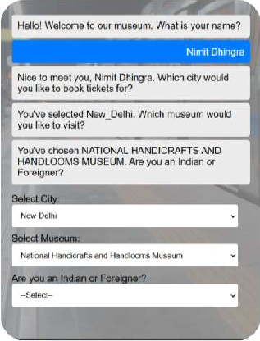
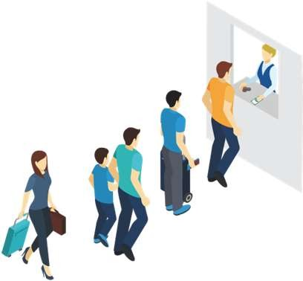

IMPACT AND BENEFITS
Enhancing the Visitor Experience
Coding Crew
Enhanced Conven ence
Visitors can easily access information, purchase tickets, and receive support through the chatbot, eliminating the need for physical lines or phone calls.
Increased Eff c ency
The chatbot streamlines operations, freeing up museum staff to focus on visitor engagement and other tasks.
Personal zed Exper ence
Tailored recommendations and information cater to individual preferences, creating a more engaging and enjoyable museum experience.

Slide 6
RESEARCH AND REFERENCES
Coding Crew
Museums in India- https://www.indiaculture.gov.in/about-us/autonomus-bodies/museum
List of museums in India- https://en.wikipedia.org/wiki/List_of_museums_in_India
Ticket Booking- https://nationalmuseumindia.gov.in/en/online-ticket-booking
HTML,CSS & JS course- https://www.youtube.com/watch?v=nu_pCVPKzTk
Login Page- Tutorial https://www.w3schools.com/howto/howto_css_login_form.asp
Include Google Translate for multilingual- https://www.youtube.com/watch?v=5meQKQhGBZg
Animation- https://www.youtube.com/watch?v=jiK6Mf-ILSg
Make ChatBot- https://www.geeksforgeeks.org/create-working-chatbot-in-html-css-javascript/ https://www.youtube.com/watch?v=LgR1ZFoJKxA

